Slide 1
2.Servlet

Slide 2
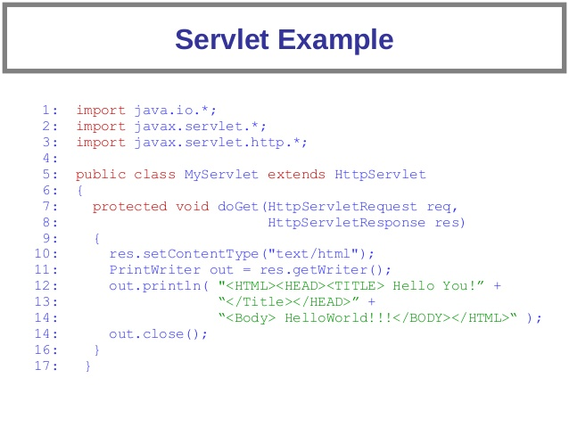

Slide 3
2.1.What is a Servlet?
The topic of Servlet is quite large, and depend on the usage context, Servlets are defined in different ways such as:
Servlet is a technology used to create web applications.
Servlet is an API that provides interfaces, classes, and documents.
A servlet is a web component that is deployed on the server to generate dynamic web pages.
Servlet can be determined as an object, but we cannot instantiate Servlet object directly like usual Java objects and it will be done by web container.

Slide 4
2.2.Difference between JSP and Servlet
Servlet
JSP
Servlet is a java code.
Servlets are faster as compared to JSP, as they have a short response time.
Servlets are more oriented to information processing.
JSP is a html based code.
JSP is slower than Servlets, as the first step in the JSP lifecycle is the conversion of JSP to Java code and then the compilation of the code.
JSPs are generally more oriented to displaying information.

Slide 5
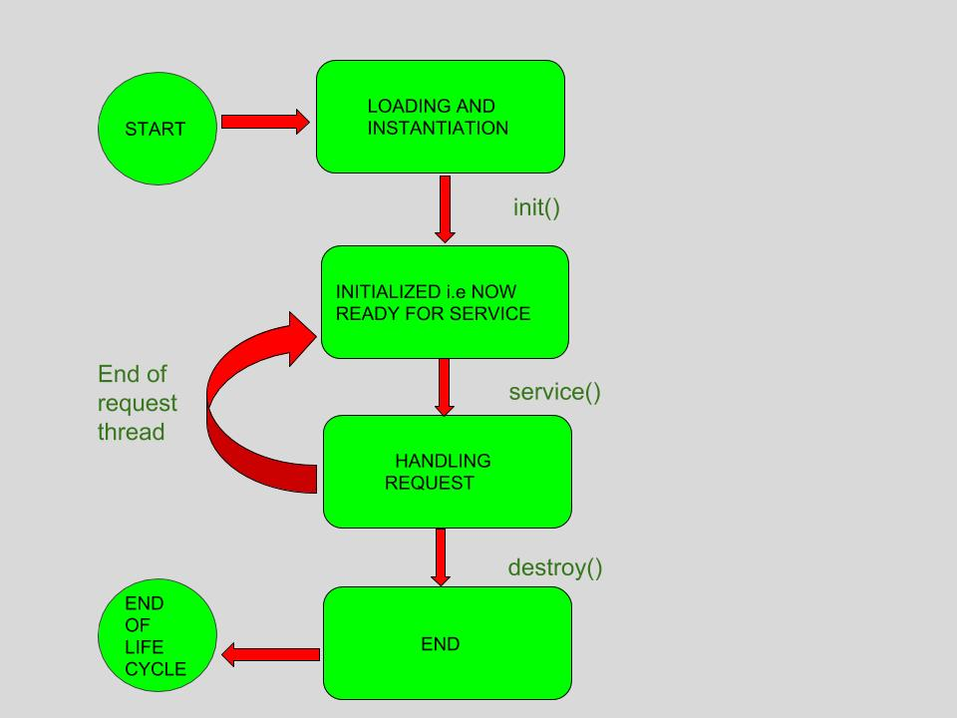
2.3.Servlet life cycle
A servlet life cycle can be defined as the entire process from its creation till the destruction. The following are the paths followed by a servlet:
The servlet is initialized by calling the init() method.
The servlet calls service() method to process a client's request.
The servlet is terminated by calling the destroy() method.
Finally, servlet is garbage collected by the garbage collector of the JVM.

Slide 6
2.3.1.The init() Method
The init method is called only once. It is called only when the servlet is created, and not called for any user requests afterwards. So, it is used for one-time initializations.
The init() method simply creates or loads some data that will be used throughout the life of the servlet.

Slide 7
2.3.2.The service() Method
The servlet container (i.e. web server) calls the service() method to handle requests coming from the client( browsers) and to write the formatted response back to the client.
Each time the server receives a request for a servlet, the server spawns a new thread and calls service. The service() method checks the HTTP request type (GET, POST, PUT, DELETE, etc.) and calls doGet, doPost, doPut, doDelete, etc. methods as appropriate.

Slide 8
2.3.3.The destroy() Method
The destroy() method is called only once at the end of the life cycle of a servlet to close database connections, halt background threads, write cookie lists or hit counts to disk, and perform other such cleanup activities.
After the destroy() method is called, the servlet object is marked for garbage collection.

Slide 9
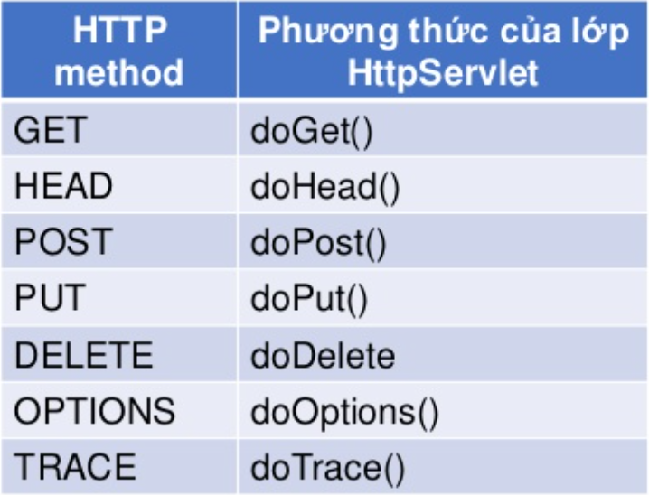
2.4.HttpServlet Class
Inherit GenericServlet class and use for Http protocol.
Depending on the method of the request, execute the corresponding function in the HttpServlet.

Slide 10
Difference between Get and Post
Get | Post
Get Request sends the request parameter as query string appended at the end of the request. | Post request send the request parameters as part of the http request body.
Get methods have maximum size is 2000 characters. | Post methods have maximum size is 8 mb.
Parameters are not encrypted | Parameters are encrypted
Get methods generally is used to query or to get some information from the server. | Post is generally used to update or post some information to the server.
Get is faster | Post is slower
Remain in browser history. | Never remain the browser history.

Slide 11
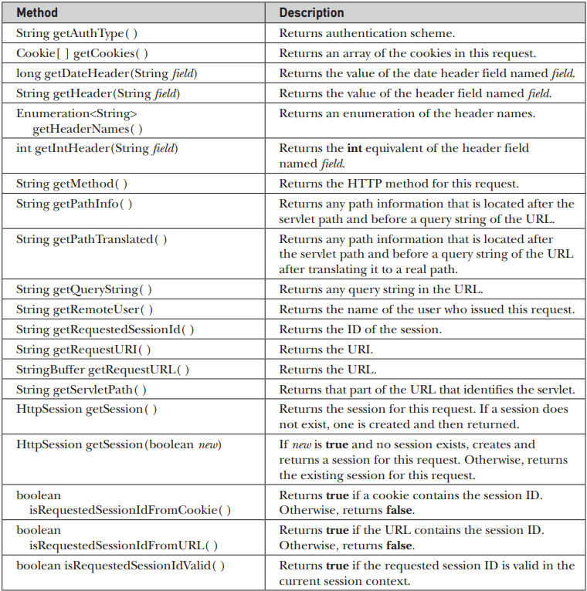
2.5.HttpServletRequest methods

Slide 12
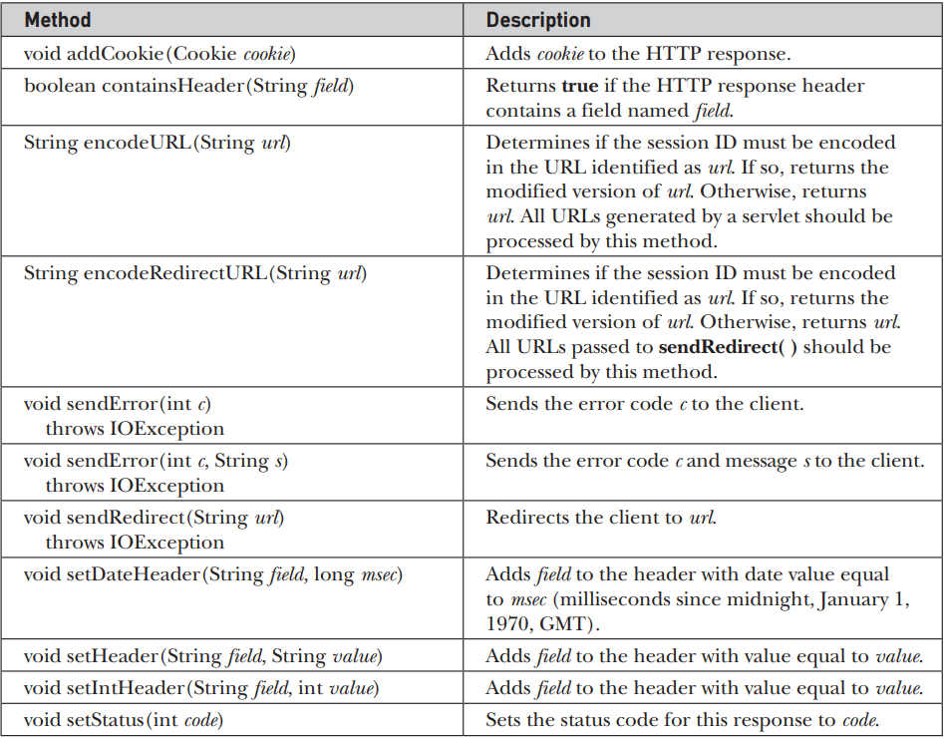
2.6.HttpServletResponse methods

Slide 13
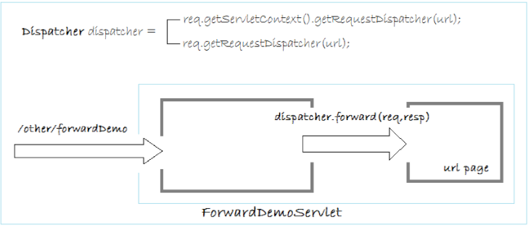
2.7.Forward Method
Forward: When a browser request is sent to a Servlet, it can forward the request to another page (or another servlet). The address on the user's browser is still the URL of the first page, but the content of the page is generated by the forwarded page.

Slide 14
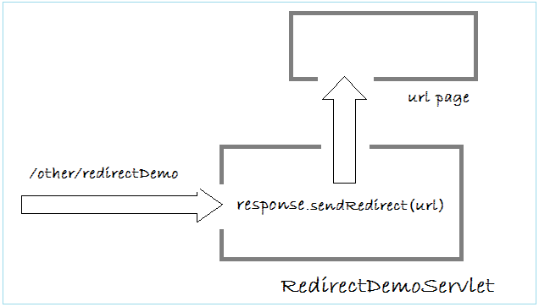
2.8.Redirect Method
Redirect: When a request from the user is sent to a Servlet (Page A), this servlet can redirect the request to another page (Page B), and finish its task. The redirected page can be a page in your application, or it can be any page. The address on the user's browser will now display the path of site B.

Slide 15
2.9.Difference between Forward and Redirect
Comparison Parameter | Forward | Redirect
Concept | is used when there is a need to forward the request from one JSP or servlet to another JSP or servlet. | is used when there is a need to redirect the request of the client to a different URL that is located on a different server.
Involvement of the client | the web container processes the request internally and thus the client does not have direct involvement in the process. | the current window is redirected to a different window and the client gets the proper information about what is going on, thus they have direct involvement in the process.
Sending data | Using forward we can send data to a forwarded page using request.setAttribute() | If we want to send data, we must store the data in the session or along with the URL.
Speed of execution | The forward command works within a single server, therefore, it operates at a faster speed. | The redirect command works slower as compared to the forward command since it operates within multiple servers.
Best using context | is most efficient when the component performs a business logic and the result is shared with another component. | works most efficiently when the client is to be redirected from one page to another.

Slide 16
2.10.Session
Session is a common concept used in programming websites that connect to a database. Especially functions such as user login and logout will be difficult to perform without using session.
Session is simply a way for us to save the data of users using the website. The session value is stored in a file on the server.
The user information is stored in session variables, and these variables can store any type of value or data type of an Object.
Each session is unique for each user, and any number of sessions can be used in an application; there is no limitation to it.
The user is identified with the help of sessionID, which is a unique number saved inside the server. It is saved as a cookie, form field, or URL.

Slide 17
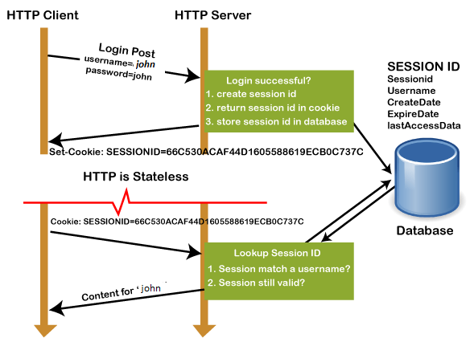
2.10.1.Working of Session
In the first step, the client request to the server via GET or POST method.
The sessionID is created on the server, and it saves the sessionID into the database. It returns the sessionId with a cookie as a response to the client.
Cookie with sessionID stored on the browser is sent back to the server. The server matches this id with the saved sessionID and sends a response HTTP200 (OK)

Slide 18
2.10.2.Why use Session?
Sessions are used to store information such as UserID over the server more securely, where it cannot be tempered.
It can also transfer the information in the form of value from one web page to another.
It can be used as an alternative to cookies for browsers that don't support cookies to store variables in a more secure way.

Slide 19
2.11.Cookie
A cookie is a small text file that is stored on the user's computer.
The cookies help the websites to keep track of the user's browsing history or cart information when they visit their sites.
It stores only the "String" data type.
The information stored within cookies is not secure because this information is stored in text-format on the client-side, which can be read by anyone.

Slide 20
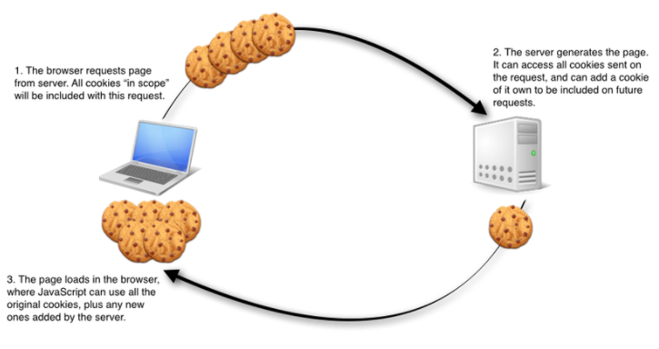
2.11.1.Working of Cookie
When a user visits a website that uses cookies, that site's web server automatically sends a cookie to the user's computer.
When visiting websites that use saved cookies, these cookies automatically send the user's information to its owner (the creator of the cookie).
Each cookie usually has a certain timeout predefined by the programmer. The information stored in cookies such as login information, user actions, frequency of website visits, access time... All of them are temporary information and are stored for a period of time.

Slide 21
2.11.2.Why use Cookie?
HTTP is a stateless protocol; hence it does not store any user information.
For this purpose, we can use Cookies. It allows us to store the information on the user's computer and track the state of applications.
Personalizing the user experience – this is achieved by allowing users to select their preferences.
The page requested that follow are personalized based on the set preferences in the cookies. Tracking the pages visited by a user.

Slide 22
2.12.Distinguish Session and Cookie
Cookie | Session
Cookies are stored on the user's browser. | Sessions are not stored in the browser.
Cookie data is stored on the client side. | Session data is stored on the server side.
Cookie data is easy to modify or steal when they are stored on the client side. | Session data is not easily modified as they are stored on the server side.
Cookie data is available in the browser until expired. | After closing the browser, the session will end.
Cookies are stored on the user's computer as a text file. | A session stores the variables and their values within a file in a temporary directory on the server.
The maximum size of the browser's cookies is 4 KB. | We can store as much data as we want within a session, but there is a maximum memory limit, which a script can use at one time, and it is 128 MB.

Slide 23
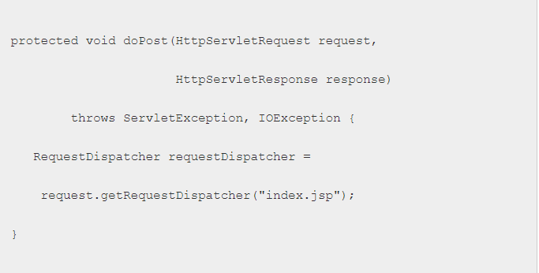
2.13.RequestDispatcher
It helps the web page to pass requests from one servlet to another by allowing another servlet to be called from within another servlet.
It creates an object that receives requests from the client and sends them to any resource like a servlet, HTML or JSP file.
Request Dispatcher includes 2 methods: Include() and Forward().
To get the RequestDispatcher object we use the getRequestDispather() method from the HttpServletRequest object.

Slide 24
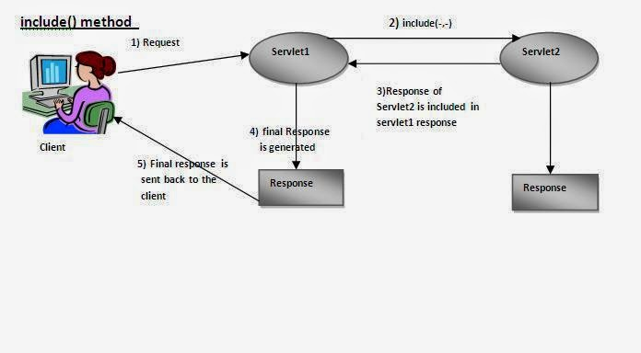
2.13.1.Include():
This is a method that allows you to insert various content into requests and then return certain Web managed by the Client.

Slide 25
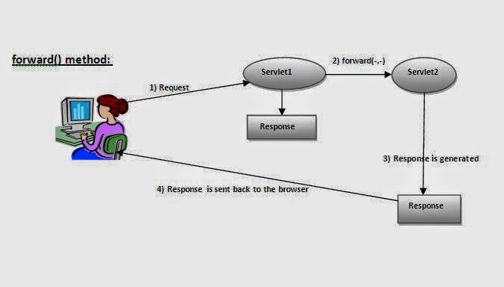
2.13.2.Forward():
This is a method that allows a Web Servlet to process a request from a client and then send it to another Web Servlet before returning it to the client.

Slide 26
2.14.Session tracking:
Session Tracking is a way to maintain state (data) of an user. It is also known as session management in servlet.
HTTP is stateless that means each request is considered as the new request.
Http protocol is a stateless so we need to maintain state using session tracking techniques. Each time user requests to the server, server treats the request as the new request. So we need to maintain the state of an user to recognize to particular user.

Slide 27
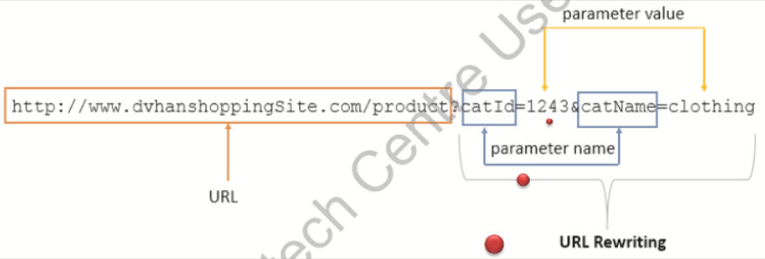
2.14.1.URL Rewriting:
You can add some extra data to the end of each URL that identifies the session, and the server can associate that session identifier with the data it has stored about that session.

Slide 28
Advantages and disadvantages
Advantages
Disadvantages
Can be concatenated when submitting data from an HTML form.
Is a good way to maintain sessions when browsers do not support cookies or users disable support for cookies.
Long URLs cannot store much information due to URL length limit(255)
The URL contains visible data information, so it's not secure

Slide 29
2.14.2.Hidden form fields:
A web server can send a hidden HTML form field along with a unique session ID.
This entry means that, when the form is submitted, the specified name and value are automatically included in the GET or POST data. Each time when web browser sends request back, then session_id value can be used to keep the track of different web browsers.

Slide 30
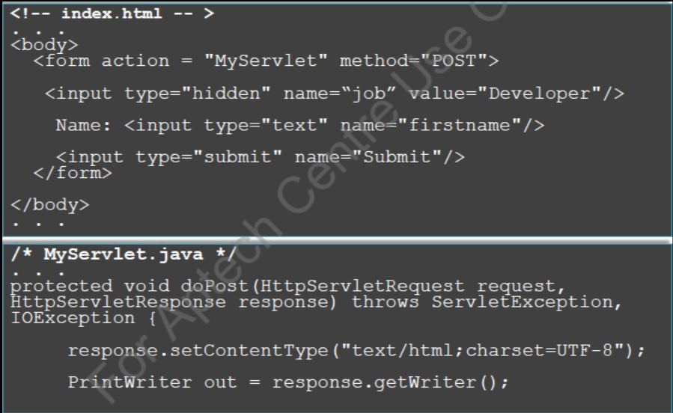
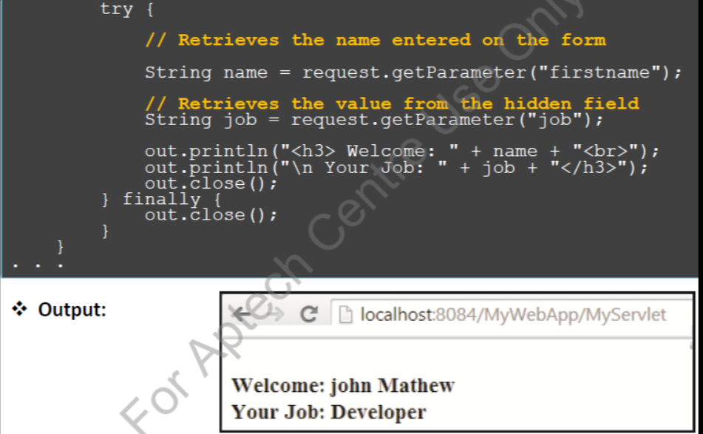
Example

Slide 31
Advantages and disadvantages
Advantages
Disadvantages
Supported in all browsers.
No special server required from the client.
Not directly visible to the user.
Works with or without cookies.
Only works when the page receives a request via a submit form.

Slide 32
2.14.3.Using HttpSession:
The servlet provides the HttpSession interface to identify a user on more than one page that requests or visits a web page and stores information about that user.
After a certain period of inactivity the session is destroyed to prevent the number of sessions from increasing indefinitely.
The Session timeout can be set either in the web.xml file or can be set by the setMaxInactiveInterval() method.

Slide 33
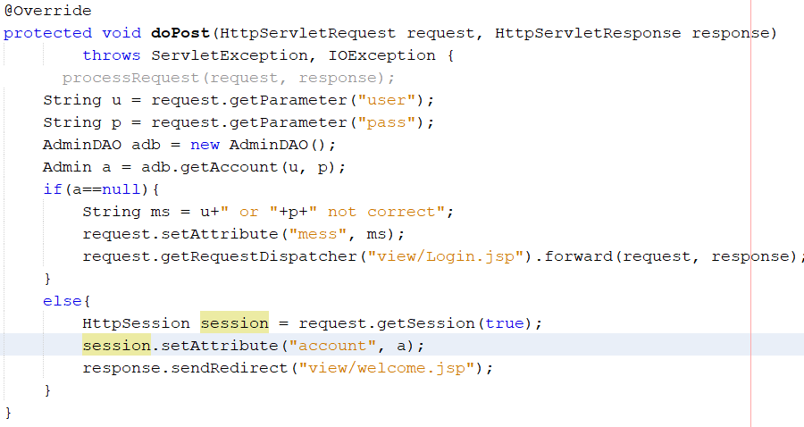
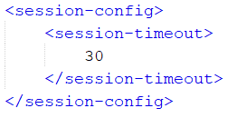
Example

Slide 34
2.15.Web filter:
Java Servlet 2.3 introduces the Filter component. Filters are used to "block", or pre-operate on the request and act-after on the response to transform or use the information contained in that request or response.
Or easier to understand, a filter object will do pre-processing (incoming request) and post-processing (returning response).
A request to a servlet, JSP or static file (.htm, .css, .js, image file, ...) and the corresponding response can be manipulated using filters.

Slide 35
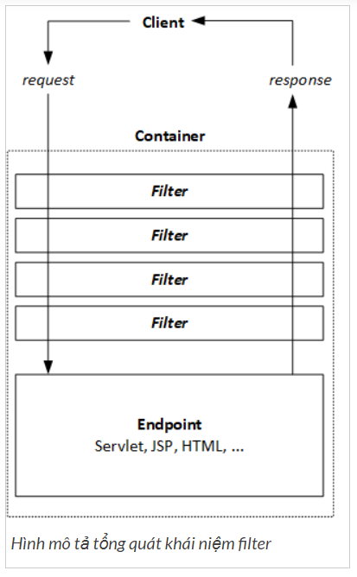
2.15.1.Filter function:
The figure aside shows some filters used to manipulate all requests and responses. It can be seen that the filters are arranged in order, the request must go through each filter in turn to reach the endpoint; Similarly, the response must also go through each filter in turn to be officially returned to the client. At each filter, there will be Java code that manipulates (interferes) specifically with the request or response.
Understand that, a request from a client to an endpoint can be forced to pass any number of filters; in a certain order; Any of these filters can interfere with the request/response, even blocking the request/response altogether.

Slide 36
So what can the filter interfere with?
Query the request and handle it accordingly.
Intercept request and response, do not let it go further (to another filter; to endpoint or client).
Edit/change the request header and request data, i.e. provide a customized version of the request (not original from the client).
Edit/change the response header and response data, i.e. provide a customized (non-original) version of the response returned by the endpoint.

